Slide 1
Application of Blockchain in Advance Study Centre
Durgesh Rajdev Vishwakarma
Dr. Hiren Dand

Slide 2
Application of Blockchain in ASC:
Components of Blockchain
Structure of Blockchain
Transaction in Blockchain
What’s Advanced Study Centre
Structure of ASC (Advance Study Centre)
Database vs. Blockchain Network
Applications of Blockchain in ASC
Conclusion & Future Work
References

Slide 3
1. Components of Blockchain
Transaction
Chronological string of the blocks arranged by cryptographic method.
Chain
Stores results of all the transactions done between two parties or individuals in particular amount of time.
An operation of adding of removal of items from public ledger, which always leads to change in structure and status of ledger.
Block

Slide 4
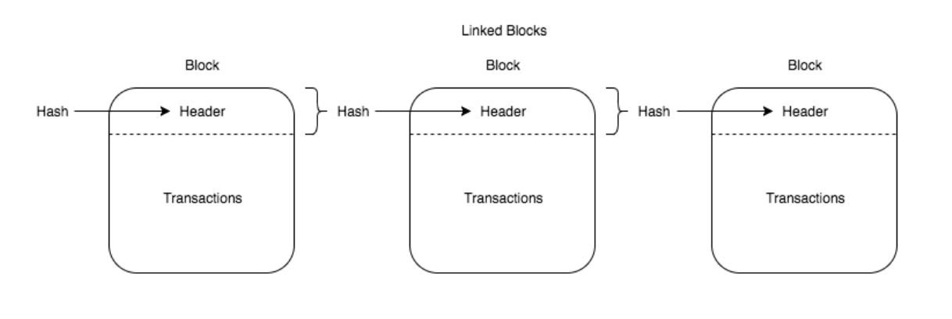
2. Structure of Blockchain

Slide 5
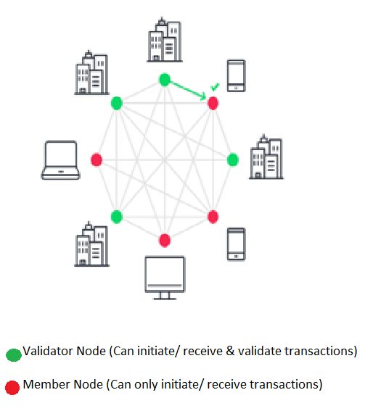
3. Transaction in Blockchain
Initially create a public distributed ledger [Read-Only]
Transaction is performed & it’s recorded in local system
Validated with each Node in the chain
If found valid transaction then block is stored in chain
Else transaction is invalid & rejected by system

Slide 6
4. What’s Advance Study Centre
Simple Educational software which was built using PHP, MySQL, PostgreSQL & Linux technologies:
PHP: Server side Scripting
MySQL & PostgreSQL: Database servers
Linux: Web Server
Follows central database structure for data storage

Slide 7
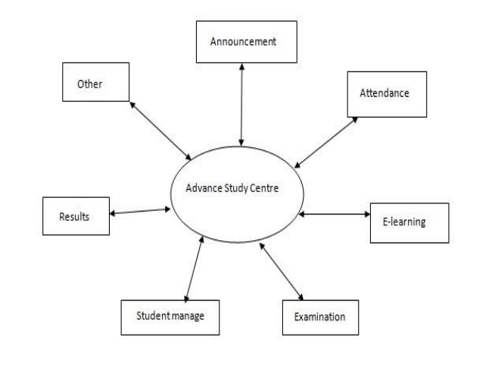
5. Structure of ASC:

Slide 8
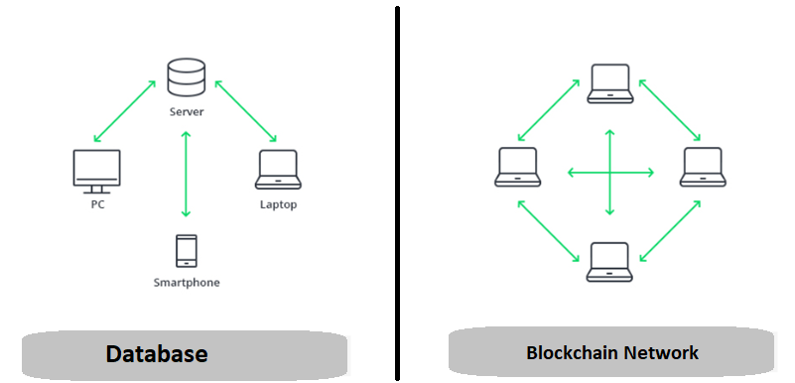
6. Database vs. Blockchain Network

Slide 9
7. Application of Blockchain in ASC:
Result Distribution on web
MIT’s Blockcert Wallet & University of Nicosia, Cyprus
Financial records
Distributed Storage
Avoid Single-point-of-failure
Maintain Data Integrity in the records:
Examination
E-Learning
Attendance
Personal Data

Slide 10
7. Application of Blockchain in ASC:
Cost reduction - lots of money is spent on sustaining centrally held databases (e.g. banks, governmental institutions) by keeping data current secure from cyber crimes and other corrupt intentions.
History of data - within a blockchain structure, it is possible to check the history of any transaction at any moment in time. This is a ever-growing archive, while a centralized database is more of a snapshot of information at a specific point.
Data validity & security - once entered, the data is hard to tamper with due to the blockchain’s nature. It takes time to proceed with record validation, since the process occurs in each independent network rather than via compound processing power. This means that the system sacrifices performance speed, but instead guarantees high data security and validity.

Slide 11
8. Conclusion & Future Work:
Implementation of Blockchain will ensure data integrity in ASC.
It will help to reduce the time required document verification by institutes or organizations.
For future work, we can evaluate the scalability issue in Blockchain.
The final aspect to be considered is to bring stockholders (teachers, students, employees and contractors) together in a way that they can interact with each other on wide-spread and trustable blockchain network.

Slide 12
9. References
Research Papers:
“Application of Blockchain Technology in Online Education” by 1. Sun, Han 2. Wang, Xinge 3. Wang, Xiaoyue published on 15th September 2018.
“A Blockchain-based Educational Record Repository” by 1. Bessa, Emanuael 2. Martins, S. B. published on January 2019.
“The Blockchain and Kudos: A Distributed System for Educational Records, Reputation and Reward” by 1. Sharples, Mike 2. John published in year 2016.
“Exploring blockchain technology and its potential applications for education” by 1. Guang Chen 2. Bing Xu, 3. Manli Lu 4. Nian-Shing Chen published on 03 January 2018.
“Blockchain in Education” by Anthony Camilleri published in December 2017.
“Blockchain Technology and its Applications for Virtual Education” by 1. Mavaluru, Dinesh 2. Arishi, Hamzah 3. Ra, Mythily published in October 2018.
“Understanding Blockchain Opportunities and Challenges” by Holotescu, Carmen published in April 2018.
Websites:
https://en.wikipedia.org/wiki/Blockcain
https://www.forbes.com
https://dataconomy.com/2019/01/how-will-blockchain-transform-the-education-system/
https://www.bacancytechnology.com/blog/blockchain-in-education-sector/amp/
https://www.researchgate.net/
http://www.vpmthane.org/adc/index.htm

Slide 13
Thank you!

